Slide 1
Budgets and budgetary control.
Cash flow forecasts / Cash budgets

Slide 2
Learning objectives
Define budgets and budgetary control and explain how they operate
Explain and illustrate the use of budgets and control information
Understand and demonstrate the use of flexible budgets
Explain the role of cash budgets and produce and interpret practical examples
Describe the main advantages of operating budgetary control in practice
Understand the role and limitations of ZBB and PPBS

Slide 3
Budgets
A plan, quantified in monetary terms, prepared and approved prior to a defined period of time, usually showing planned income to be generated and/or expenditure to be incurred during that period, and the capital to be employed to attaining a given objective

Slide 4
Characteristics of budgets
Stated objectives
Approved plan
Realistic forecasts
Used for budgetary control
Gives managers targets and responsibilities

Slide 5
Budgetary control
The establishment of budgets relating the responsibilities of executives to the requirements of a policy, and the continuous comparison of actual with budgeted results, either to secure by individual action the objective of that policy, or to provide a basis for its revision.

Slide 6
Implementing budgetary control
Budgets are produced for all parts of the organization
Budget manual standardizes preparation
Master Budget
Summarizes all the individual budgets
Income statement, balance sheet and cash flow statement

Slide 7
Master Budget Process
Forecast the Sales Demand
Limiting factor on which all budgets will depend
Use of qualitative methods
Use of quantitative methods
Sales Budget is the first budget prepared
Produce other budgets to meet Sales Forecast
Finished goods inventory budget, Production Budget, Materials budget, Labour budget, Overheads budget, Administration budget, Distribution budget; Capital Expenditure budget

Slide 8
Different types of Budgets
Annual Budgets
Produced once in the year
New budgets are not produced till the end of the year
Rolling budgets
This means that the budget is produced for the following 12 months; then, each month, another month is added and the month just passed dropped
There is always a 12 month budget available
Constant up-dating

Slide 9
Fixed and Flexible Budgets
Fixed budget
Assumes a given level of production and sales
Flexible budget
Budget that recognizes changes in level of activity
Costs identified as fixed or variable
Used for variance calculations

Slide 10
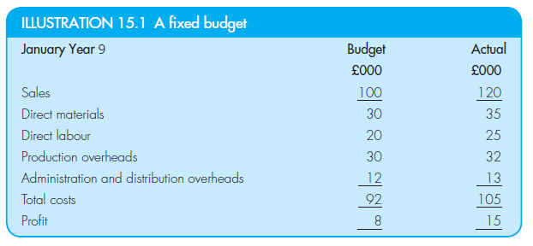
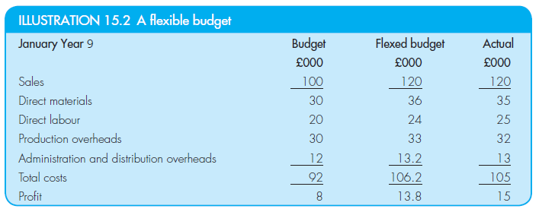
Fixed and Flexible Budgets

Slide 11
Cash Budget
Forecasted cash receipts and cash payments
Usually prepared on a monthly basis
Forecast of amount and the timing of cash flow movement
Possible cash shortages identified and planned for
Possible cash surpluses may be invested

Slide 12
Cash budgets
Receipts
Payments
Cash sales
Cash from receivables
Sale of shares
Issue of loans
Expenses
Payments to suppliers
Cash purchases
Dividends
Taxation

Slide 13
Advantages of Budgetary Control Systems
Identifies objectives
Identifies limiting factors
Authorizes actions
Assigns responsibilities
Delegation
Management by exception
Control
Motivation
Communication
Performance evaluation

Slide 14
Problems of budgetary control
Realistic levels of performance are needed
Participation of managers necessary
Reward schemes
Competition for resources
Incremental budgeting
Paperwork exercise
Spending up to budget
An end in itself
Defining objectives

Slide 15
Incremental Budgeting
The easiest way to produce a budget is simply to base it on the previous year’s actual results, and add a bit for inflation, and a bit more for growth.
But this is estimating what is likely to happen.
It is not planning to achieve desired results.
It is likely to produce budgets that are easily achievable.
But this ‘easy’ approach is not best designed to help the organization to achieve its objectives.

Slide 16
Zero based budgeting (ZBB)
Each year budget from zero expenditure rather than incrementally
Managers must justify their budget requests
Questioning attitude for each item of expenditure
Activities divided into “decision packages”
Some activities may be “axed”

Slide 17
ZBB benefits and problems
Can help to identify and remove inefficient operations
Enables efficient allocation of resources
Greater profitability and attention to effectiveness
But...
Expensive to apply
Substantial volume of work

Slide 18
Planning, Programming Budgeting Systems (PPBS)
Used in public sector organizations
Defence, policing
Necessary to define programmes that make up the function
Allocate budget to each programme
Measure effectiveness of each programme on terms of expenditure used and benefits obtained

